Slide 1
An introduction to Dynamic Factor Analysis
Mark Scheuerell
FISH 507 – Applied Time Series Analysis
9 February 2017

Slide 2
Iterative approach to model building
Postulate general class of models
Identify candidate model
Estimate parameters
Diagnostics:
is model adequate?
Use model for forecasting or control
No
Yes

Slide 3
Observations of one or more states
We have learned several forms of models for analyzing ts
General idea is to reduce the ts to trend(s), seasonal effect(s) & stationary remainder
When we have multiple ts, we have modeled them as observations of 1+ states (see Lec 6)

Slide 4
Observations of one or more states
For example, recall our analyses of Pacific harbor seals
3 “true” populations
JF
N
S
5 observations

Slide 5
Finding common patterns in data
What if our observations were not of simply 1 state, but were instead a mixture of 2+ states (eg, we sampled a haul-out in between 2 breeding sites)?

Slide 6
Observations of one or more states
Returning to our analyses of Pacific harbor seals
3 “true” populations
JF
N
S
5 observations

Slide 7
Finding common patterns in data
What if our observations were not of simply 1 state, but were instead a mixture of 2+ states (eg, we sampled a haul-out in between 2 breeding sites)?
What if some unknown & unmeasured environmental drivers created common patterns among our ts (eg, adult salmon in the North Pacific)?
We know how many observations we have, but we don’t know the number of states!
So, what are the dimensions of Z?

Slide 8
Finding common patterns in data
What if our observations were not of simply 1 state, but were instead a mixture of 2+ states (eg, we sampled a haul-out in between 2 breeding sites)?
What if some unknown & unmeasured environmental drivers created common patterns among our ts (eg, adult salmon in the North Pacific)?
Perhaps we could use a few common trends to describe much/most of the variance in the observations?
Dynamic Factor Analysis (DFA) is an approach to ts modeling that does just that

Slide 9
Let’s start with PCA
PCA stands for Principal Component Analysis
Goal is to reduce some correlated variables to fewer uncorrelated values
Number of principal components is generally less than the number of original variables

Slide 10
A graphical example

Slide 11
Adding in the first 2 PC’s

Slide 12
And rotating the basis

Slide 13
What exactly is DFA?
It’s like PCA for time series
DFA can indicate whether there are any:
underlying common patterns/trends in the time series,
interactions between the response variables, and
what the effects of explanatory variables are.
The mathematics are a bit complex—for details, see Zuur et al. (2003) Environmetrics

Slide 14
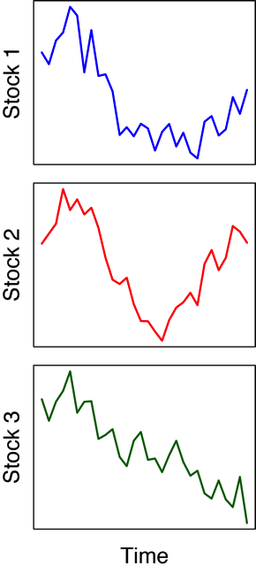
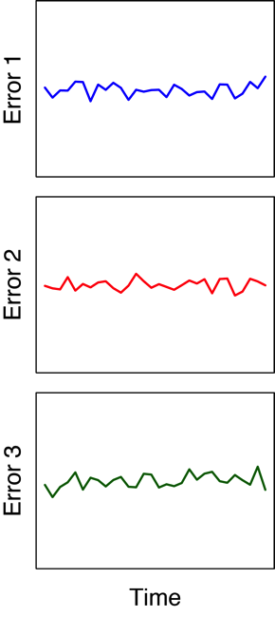
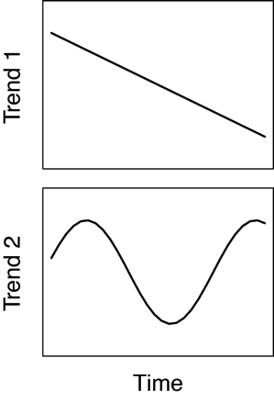
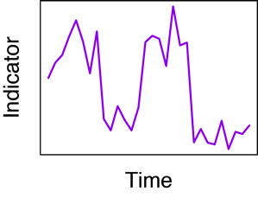
DFA in common terms
Data
Trend(s)
Covariate(s)
Errors
=
+
+

Slide 15
DFA in matrix form
State equation
Common trends over time
Observation equation
Relate trends (x) to observations (y) via Z

Slide 16
DFA with covariates
State equation
Common trends over time
Observation equation
Relate trends (x) to observations (y) via Z,
and covariates (d) to y via D

Slide 17
Examining the Z matrix
Observation equation
1 state?
2 states?
3 states?
We will use model selection criteria to decide

Slide 18
Relationship between PCA & DFA
Similarity with PCA can be seen via
In PCA, however, R is constrained to be diagonal
Not so in DFA
Zuur et al. (2003)

Slide 19
Various forms for R
Diagonal & equal
Equal variance & covariance
Diagonal & unequal
Spp-specific variances & covariances

Slide 20
Some caveats in fitting DFA models
State equation
Observation equation
Infinite combinations!
Harvey et al. (1989); Zuur et al. (2003)

Slide 21
Some caveats in fitting DFA models
State equation
1) Set Q = Identity
Observation equation
2) Constrain portions of Z and a
Harvey et al. (1989); Zuur et al. (2003)

Slide 22
Constraining the a vector
Observation equation
Constraining portions of a (eg, n = 5; m = 3)
Harvey et al. (1989); Zuur et al. (2003)

Slide 23
Constraining the a vector
Observation equation
Constraining portions of a (eg, n = 5; m = 3)
Note: This approach causes the EM algorithm to take a very long time to converge
Soln: We will demean our data and set a = 0
Harvey et al. (1989); Zuur et al. (2003)

Slide 24
Constraining the Z matrix
Observation equation
Constraining portions of Z (eg, n = 5; m = 3)
Harvey et al. (1989); Zuur et al. (2003)

Slide 25
Constraining the Z matrix
Observation equation
Constraining portions of Z (eg, n = 5; m = 3)
Harvey et al. (1989); Zuur et al. (2003)

Slide 26
Rotation matrix H
We arbitrarily constrained Z to obtain just 1 of ∞ solutions
(1)
Harvey et al. (1989)

Slide 27
Rotation matrix H
If H is m x m non-singular matrix, these 2 models are equivalent
(1)
We need to choose appropriate H — we’ll use “varimax”
(2)
Harvey et al. (1989)

Slide 28
Varimax rotation for H
A “simple” solution means each factor has a small number of large loadings, and a large number of (near) zero loadings
After varimax rotation, each original variable tends to be associated with one (or a small number) of factors
Varimax searches for a linear combination of original factors that maximizes the variance of the loadings

Slide 29
Varimax rotation for H
For example, PCA on wine descriptions

Slide 30
Varimax rotation for H
After varimax rotation

Slide 31
A note of caution for model selection
Some people compare data support for models with and without covariates, and varying numbers of trends
But, this has to be done in a well reasoned manner
This is an undetermined random walk
This is a predetermined covariate
Unless d_{t} is very highly correlated with y_{t}, then the trend-only models will be selected

Slide 32
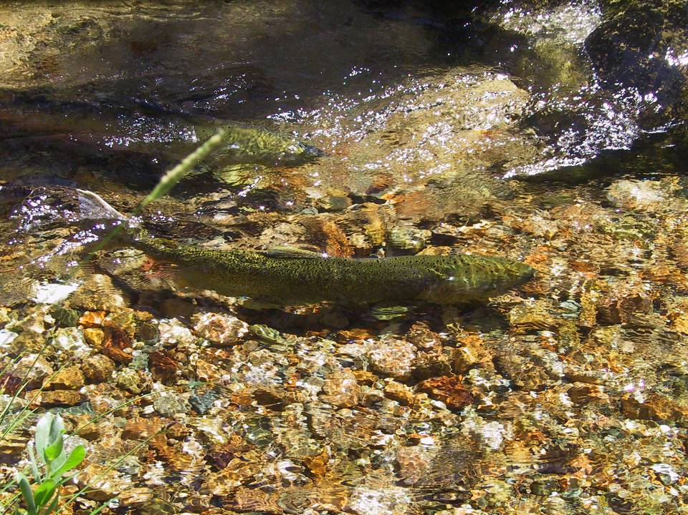

Slide 33


Slide 34
Arctic-Yukon-Kuskokwim salmon
Poor returns of Chinook & chum in AYK region over past decade have led to severe restrictions on commercial & subsistence harvest
This has also led to repeated disaster declarations by the state and federal governments (nobody fished in 2012!).
In response, native regional organizations, state and federal agencies formed an innovative partnership to cooperatively address problems (AYK SSI)

Slide 35
The data
15 stocks of Alaskan Chinook
Brood years 1976-2005
Response is log(Recruits/Spawner)
Covariates lagged by 1-5 years

Slide 37
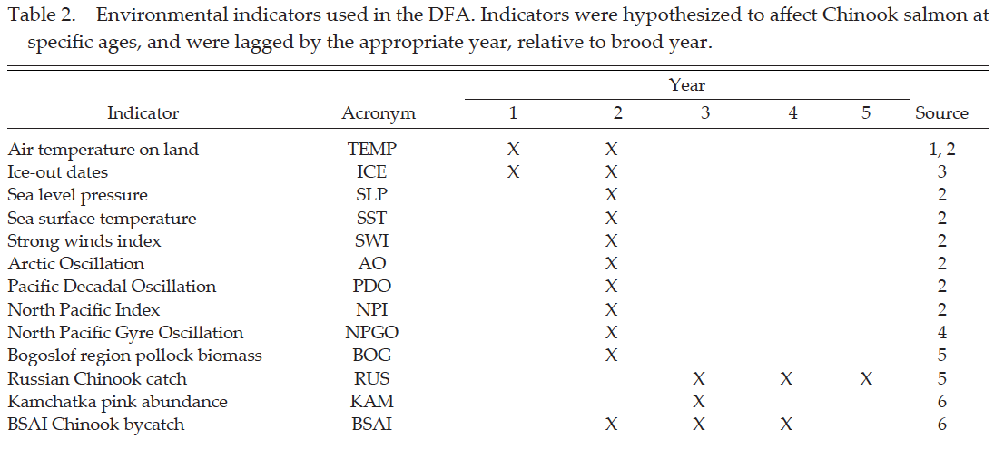
Environmental indicators

Slide 38
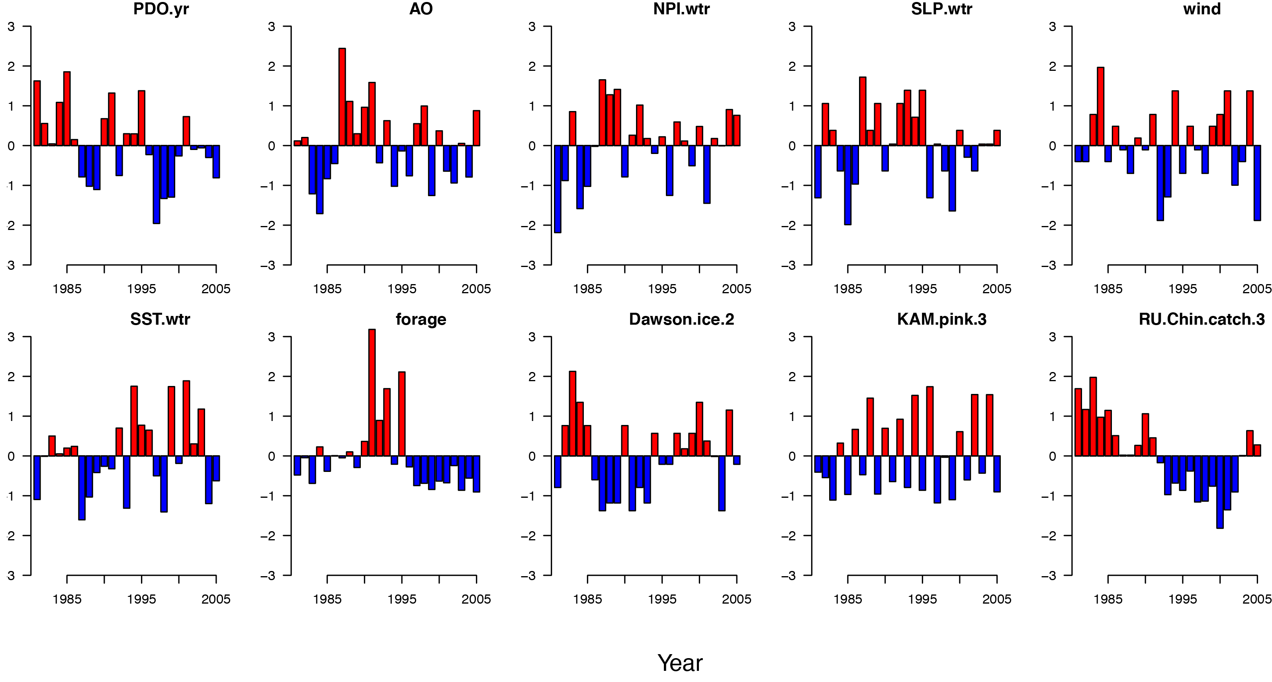
Examples of some indicators

Slide 39
The analysis
Varied the number of states/trends from 1-3
Varied forms of R to try:
Diagonal and equal,
Diagonal and unequal,
Equal variances and covariances.
Used AICc to select “best”model

Slide 40
Statewide results
The most parsimonious model had:
2 common trends
North Pacific Gyre Oscillation

Slide 41
Statewide results

Slide 42
Statewide results – covariate effect

Slide 43
Regional results

Slide 44
Regional results – covariate effect

Slide 45
Fits to data

Slide 46
Forecasting ability

Slide 47
Topics for lab
Fitting DFA models without covariates
Fitting DFA models with covariates
Doing factor rotations

